Slide 1
Gender Pay gap Visual Analytics Group no 3 Pratiksha Gupta Prathyusha Reddy Midudhula

Slide 2
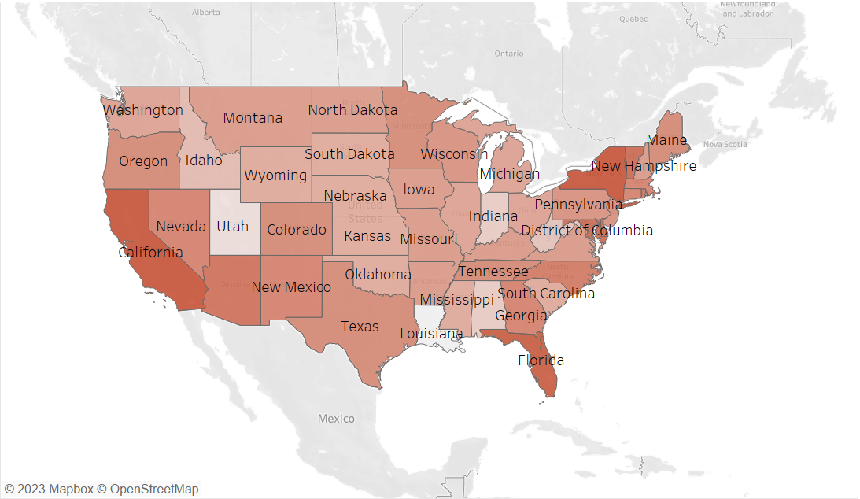
Map Chart
Highest pay gap in states like California, Florida, New York
Lowest in places like Utah and Louisiana
Pay percentage ration in UK : 77%
Factors influencing :
Ration of Urban to Rural population.
State size (bigger have higher pay gap)
Cost of Living
Education and Industry
Labor Market Dynamics

